Slide 1
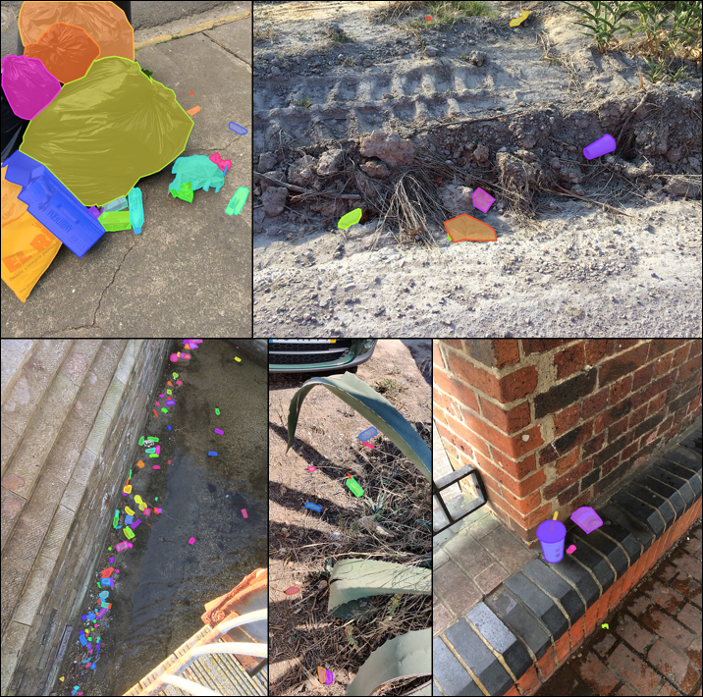

Searching for Litter with Computer Vision
Julian Hernandez
Mentor: Dr. Fitzgerald
California State University, Sacramento
MKN Heartland McNair Conference
Aug 2022

Slide 2
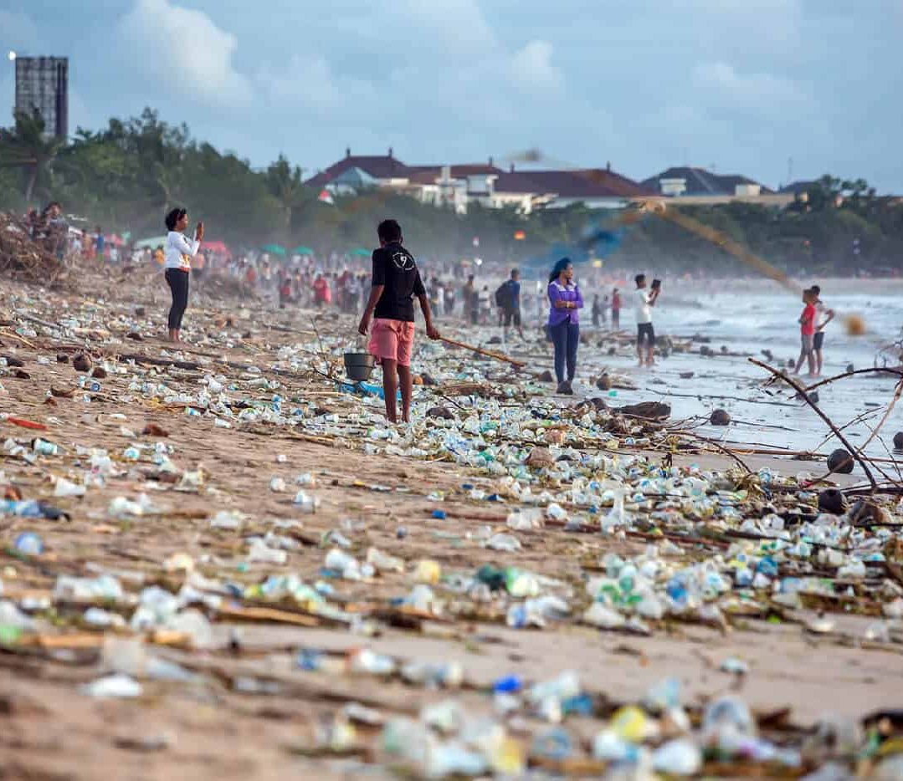
The Trash Problem
Causes harm to wildlife
Contaminates soil and ground water
Costs a lot of money to recycle
Releases green-house gas emissions

Slide 3
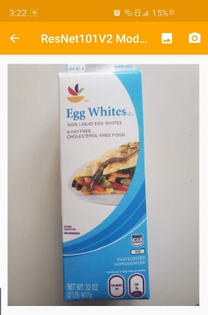
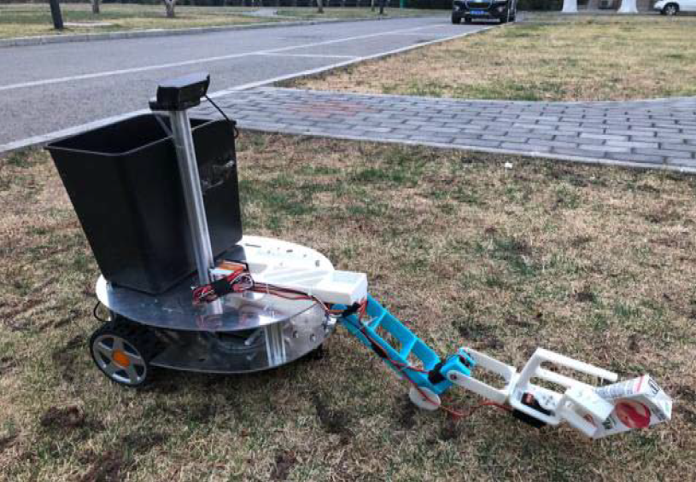
Early Trash Detection
An android app uses computer vision to classify trash into 6 material types on a blank background
A prototype trash cleanup robot designed to clean up trash in grassy areas showed promising results

Slide 4
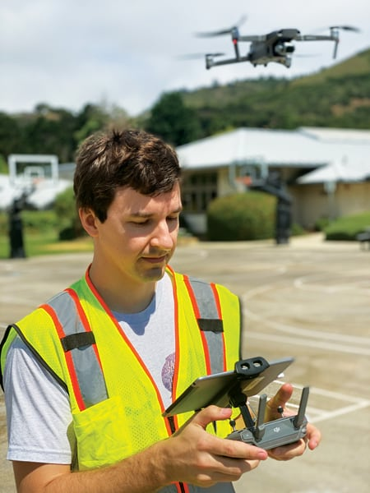
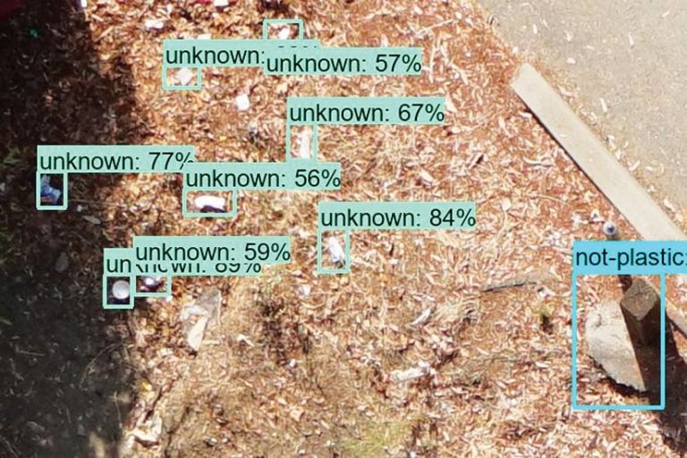
California Regulations
In 2015 new regulations Department of Water Resources require cities to measure plastics
San Francisco Estuary Institute uses computer vision to “find the best ways to filter their stormwater and stop contaminants such as trash and plastics from entering their protected wetlands and public waterways” Hale

Slide 5
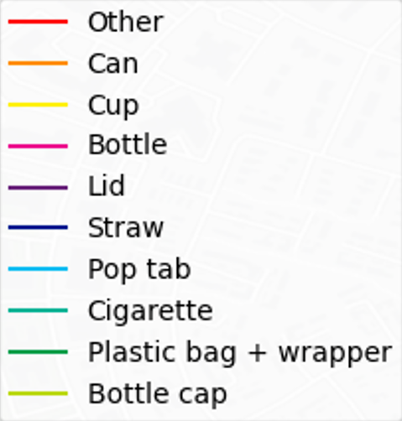
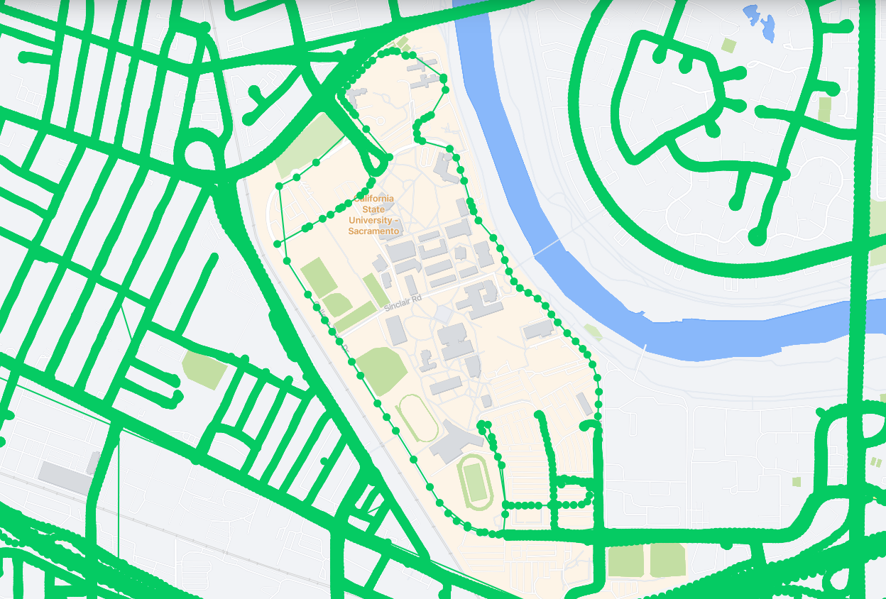
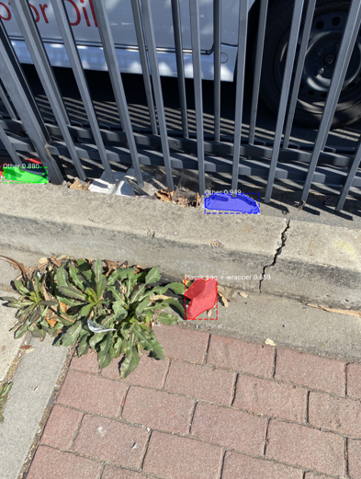
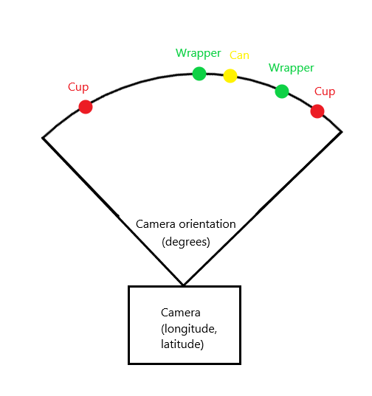
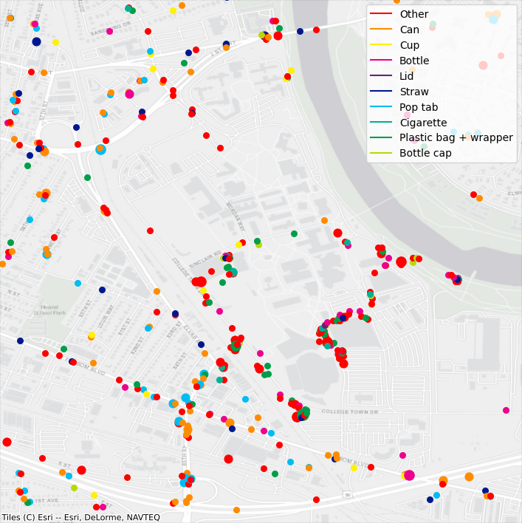
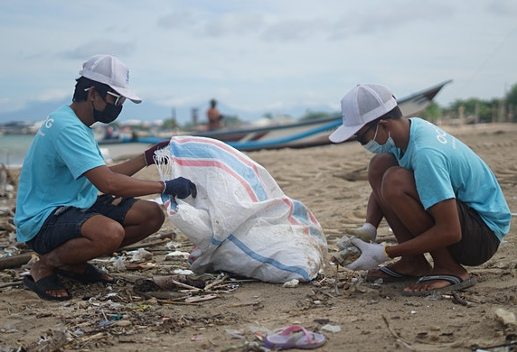
Goal of this Research
Can computer vision quantify street-side litter from collected images?
Geolocate items
Plot detections
Collect images
Detect trash

Slide 6
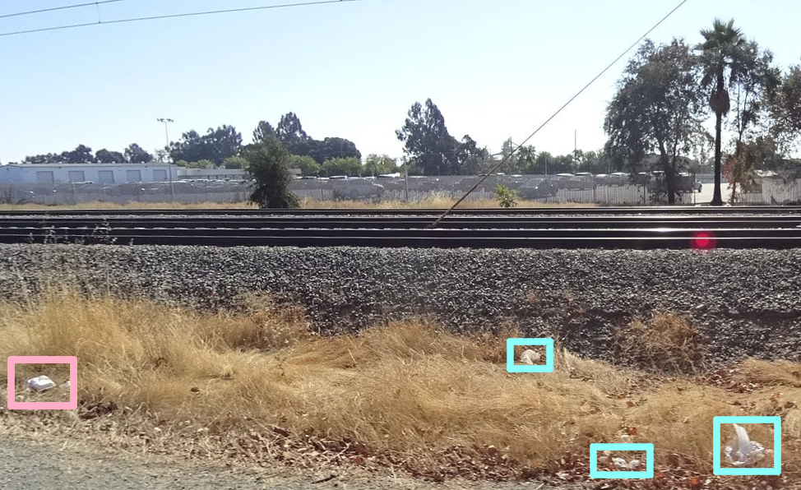
Street Level Images: Mapillary
Began collecting dashcam footage in 2013
Coverage for the 190 countries’ road networks
Mapillary image cover around Sacramento State University
Sample Mapillary image with trash

Slide 7
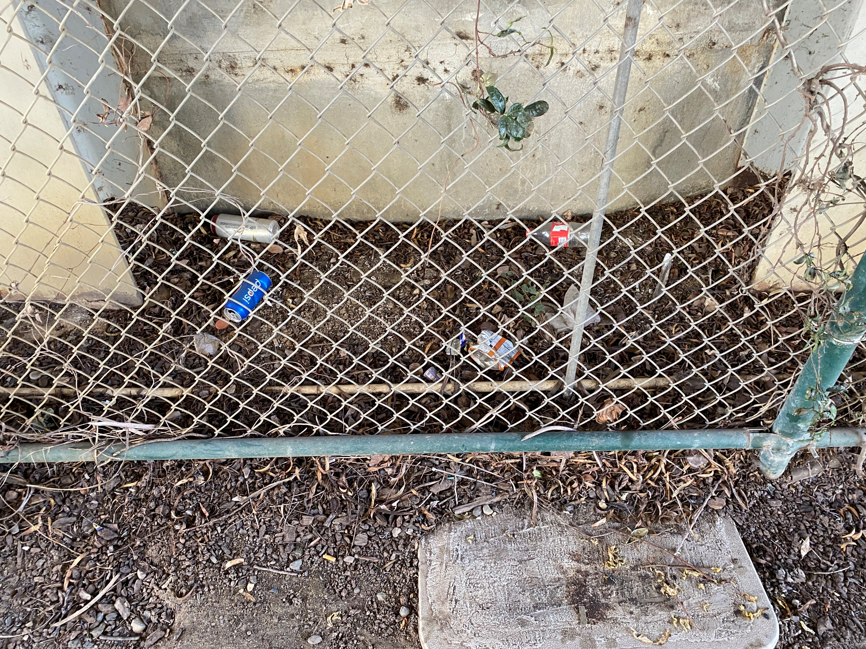
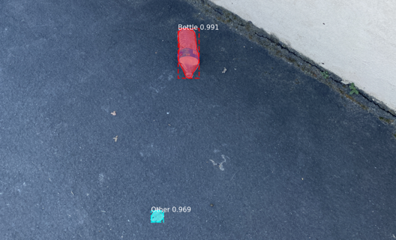
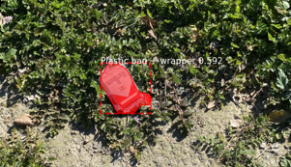
Cleanup Images
Collected 150 images from around Sacramento State University
Can be taken on any smartphone or handheld device
Coordinates and other metadata are automatically stored

Slide 8
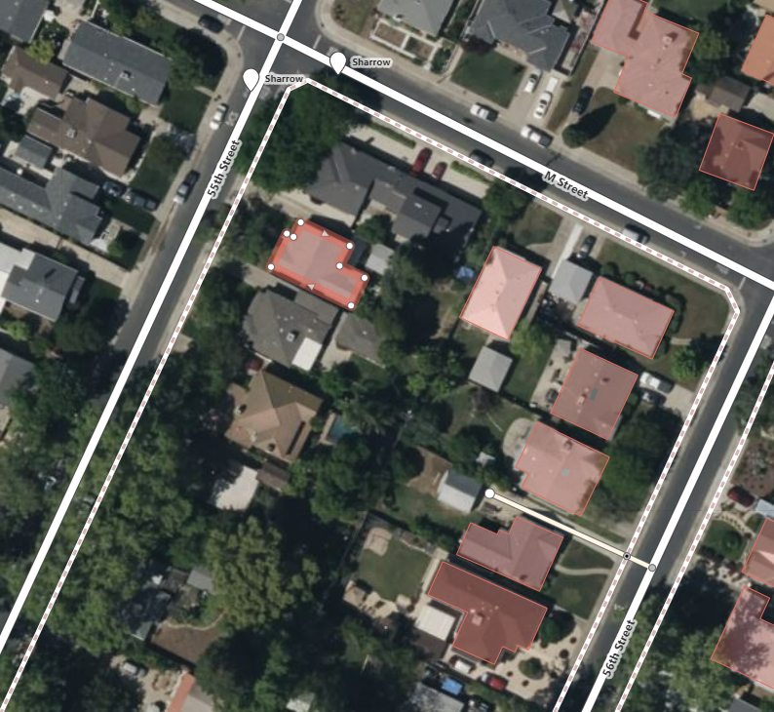
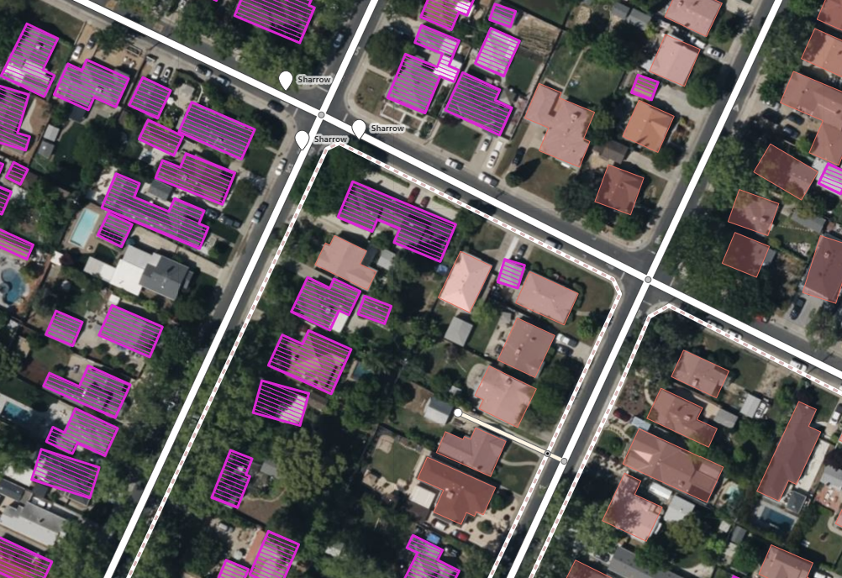
Mask Regional Convolutional Neural Network (Mask R-CNN)
Facebook releases a plugin using Mask R-CNN to suggest building outlines for OpenStreetMap
Building shapes were used as training data, allowing it predict new rooftop outlines
Training data (Red)
Training data (Red)
Mask R-CNN predictions (Purple)

Slide 9
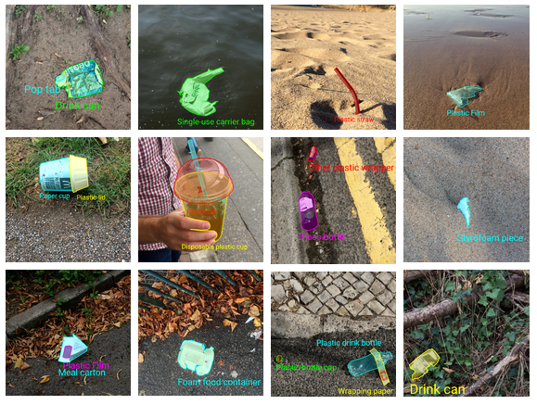
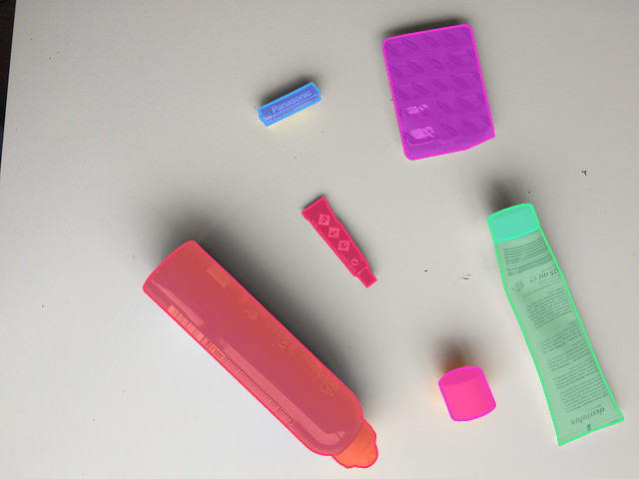
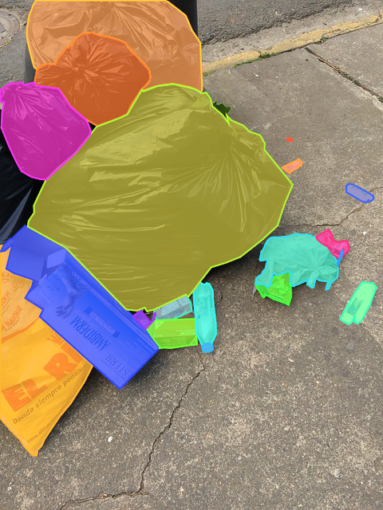
Trash Annotations in Context Dataset (TACO)
Photos and annotations can be added by the community
Contains 1,500 annotated images
60 categories

Slide 10
Localization
EXIF metadata contains photo coordinates, camera orientation, date and time, etc
Depth must be derived from object size
only works for objects with consistent volume
Pedro F. Proença (co-author of TACO dataset) went on to research RGBD Color (Red Green Blue) and Depth

Slide 11
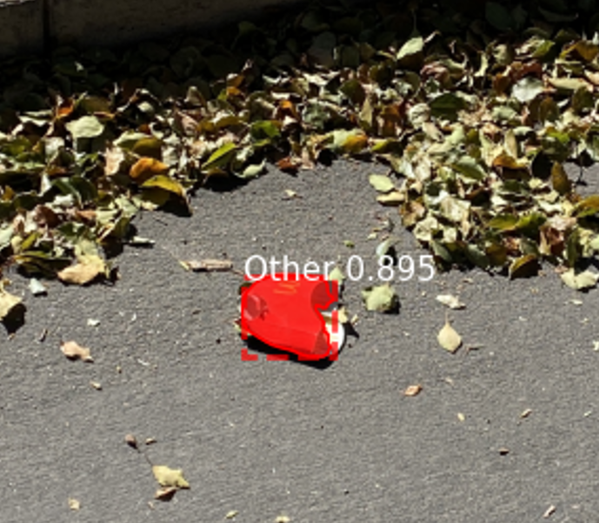
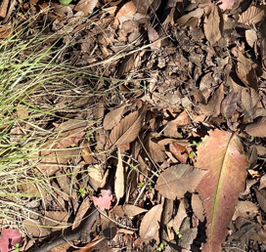
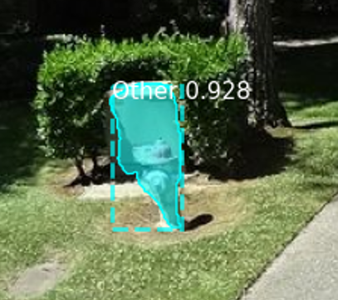
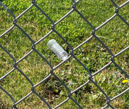
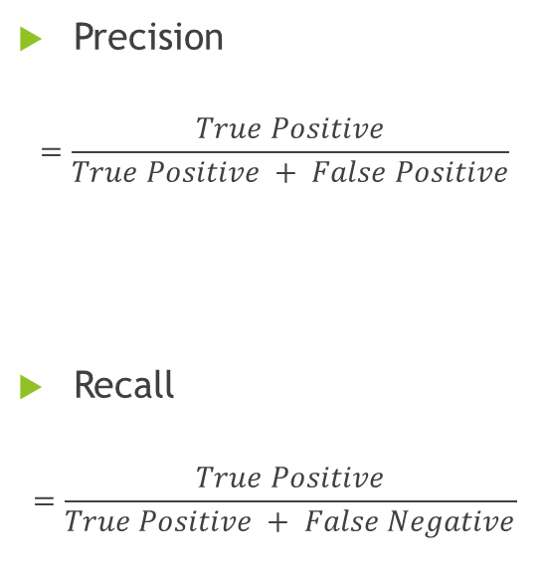
Metrics
 | Positive | Negative
True | True Positive (TP) | True Negative (TN)
False | False Positive (FP) | False Negative (FN)
Precision
$$=\frac{True Positive}{True Positive + False Positive}$$
Recall
$$=\frac{True Positive}{True Positive + False Negative}$$

Slide 12
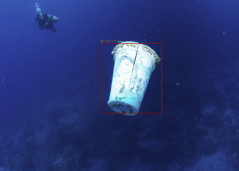
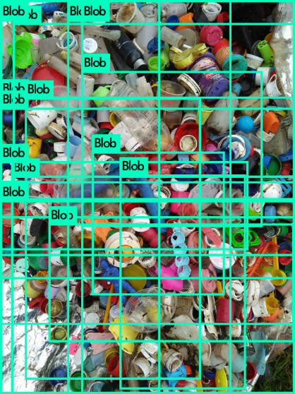
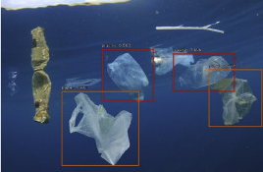
Previous Results
TrashNet precision with video:
Precision: 68%
Recall: 69%
National College of Ireland:
Precision 69%
Recall 69%
AuqaVision based on TACO:
Precision: 81%

Slide 13
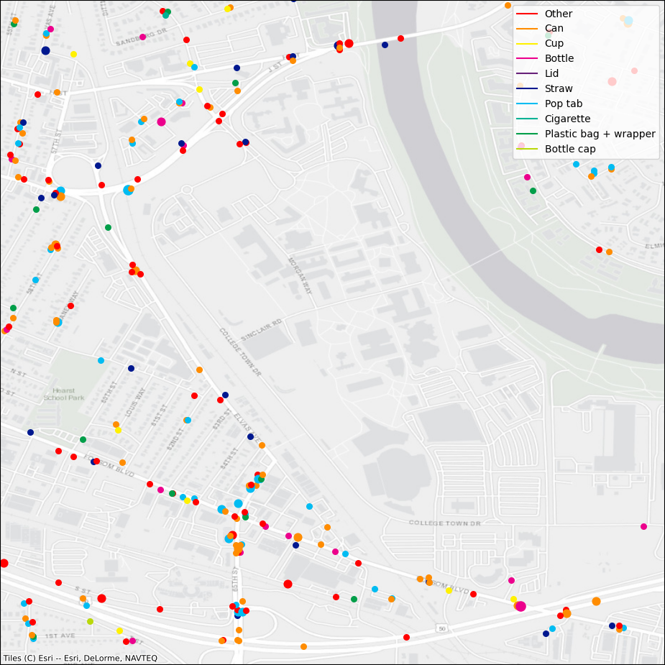
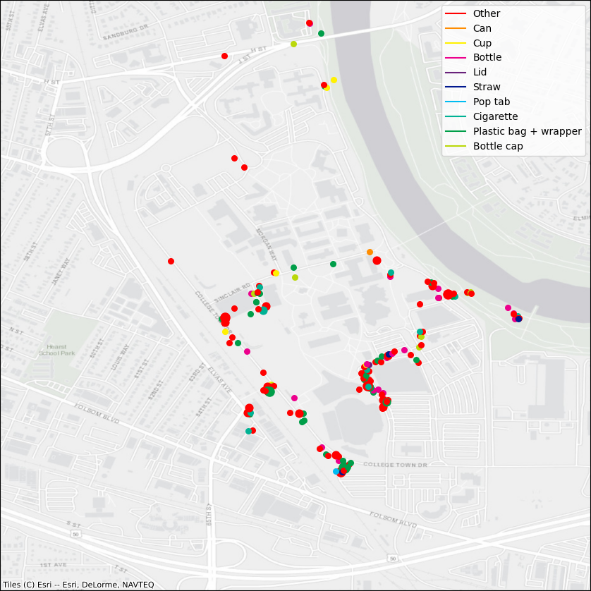
Results
River Cleanup: precision = 81% recall = 74%
Mapillary: precision = 1% recall = 3%
Mapillary dash cams
Why did the algorithm perform as expected with smartphone images while failing to do the same with Mapillary images?
Smartphone images

Slide 14
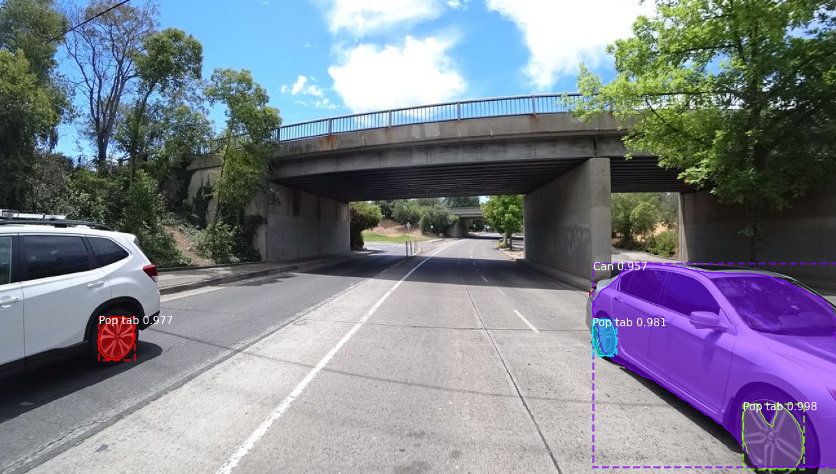
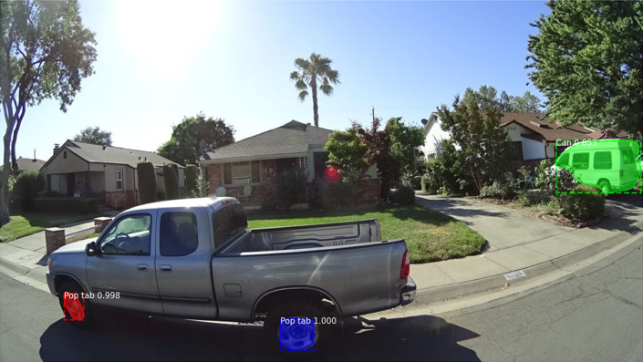
Problems
50% of false positives were from car misclassifications alone
Common features: Texture, color, and shape
Low resolution Mapillary images
Less pixels = more noise
Model was overfit to TACO dataset
The dataset needs more diverse images

Slide 15
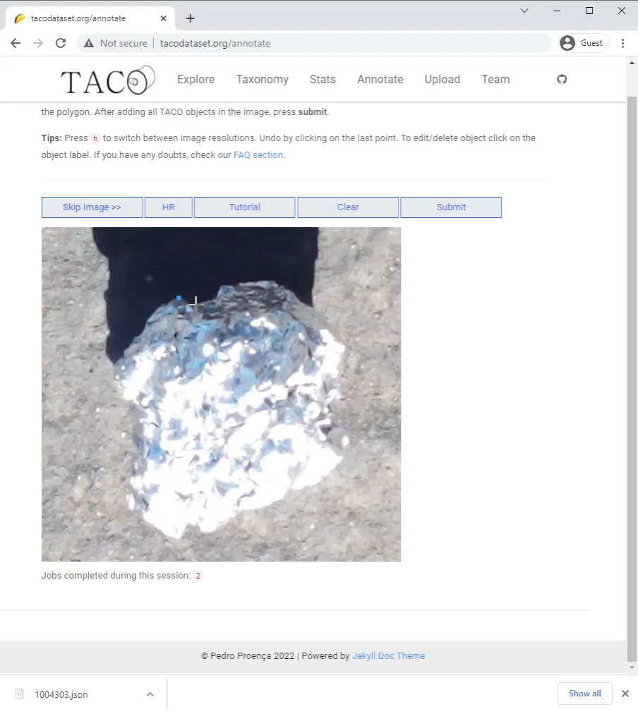
Add More Images To TACO
TACO is based on COCO but is
200–400x small
Trash Annotations in Context (TACO):
1,500 images
4,700 outlined objects
Common Objects in Context (COCO):
300,000 images
2,000,000 outlined objects

Slide 16
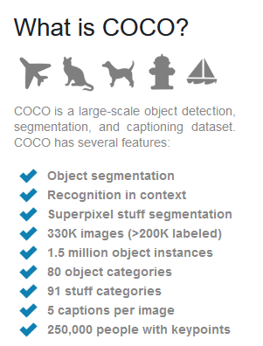
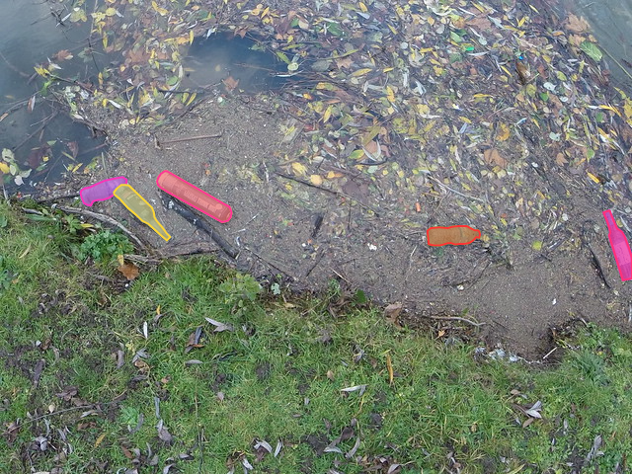
Dataset & Model Improvement
Collect and upload a diverse set of images, using COCO as a standard to work towards
Train new models these images and compare against the currently released model

Slide 17
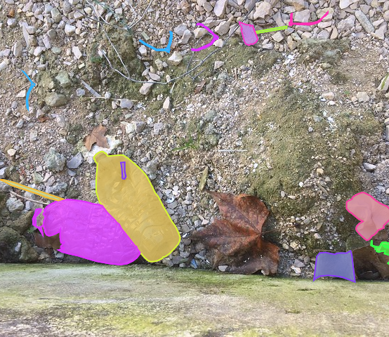
Future Work
How to apply trash detection to make real world improvements?

Slide 18
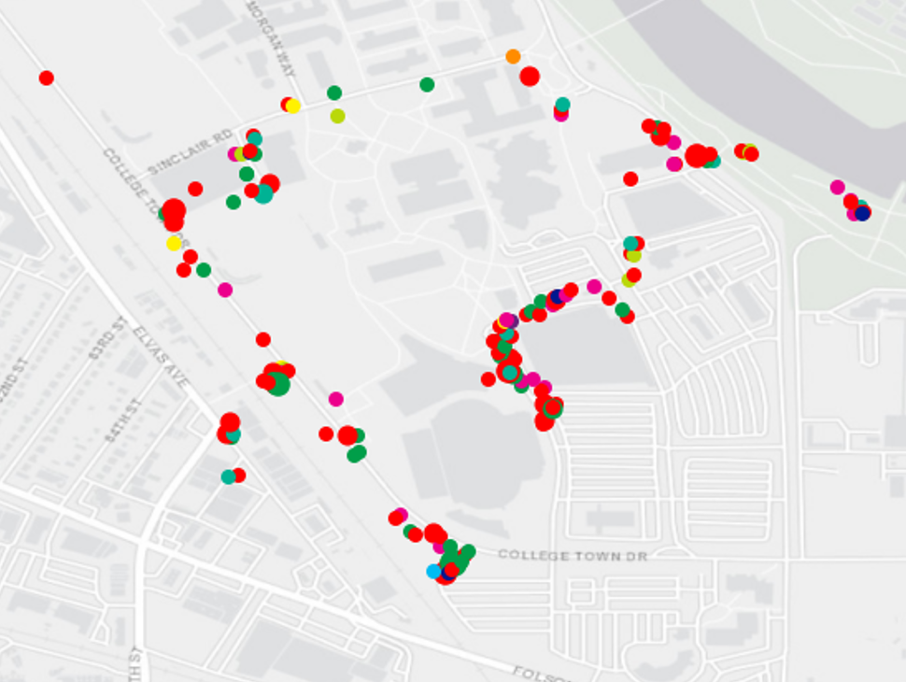
Quantify Clean Up Activities
Help environmental up organizations measure total removed litter
Look at trends over time to predict when to go back to clean again

Slide 19
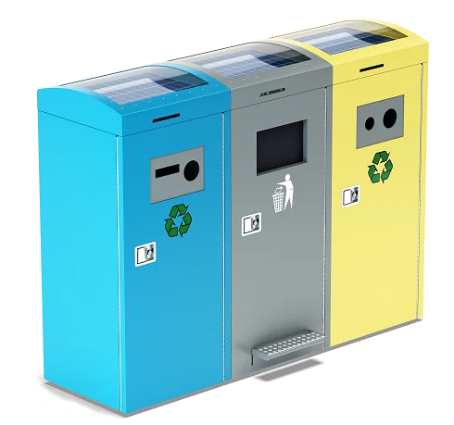
Smart Composting & Recycling
Does suggesting the correct bin increase recycling rates?
California has a “42% recycling/composting rate in 2020, up from 37% the year before. California’s goal for 2020 had been 75%, however.” resource-recycling.com

Slide 20
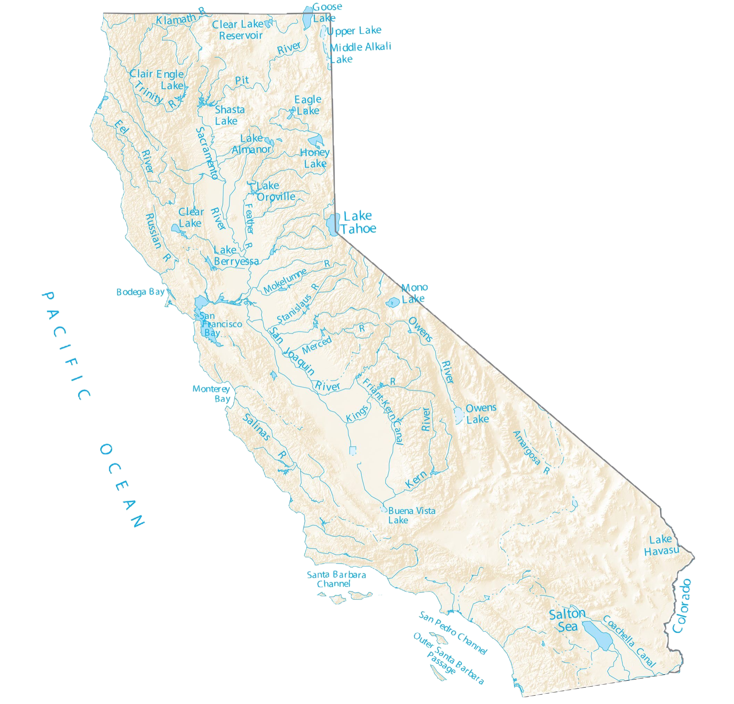
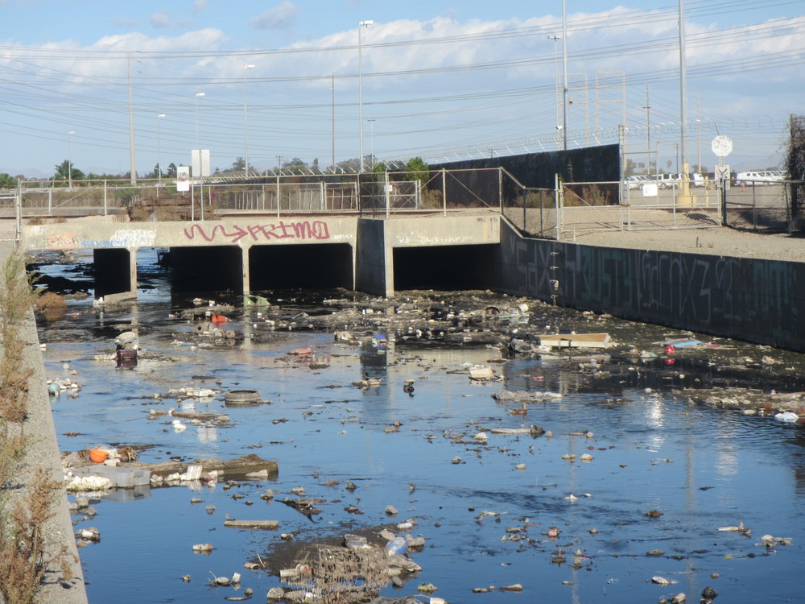
Measuring plastic in Waterways
How can the amount of trash entering and exiting the waterways be monitored?
Work with recollect, City of Sacramento, San Francisco Estuary Institute (SFEI)

Slide 21
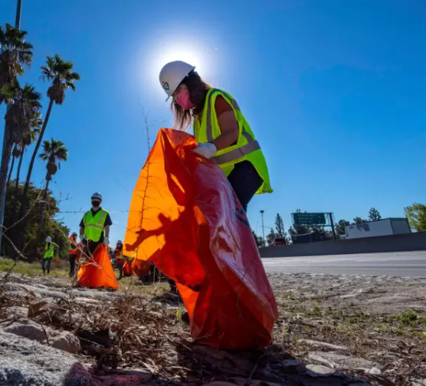
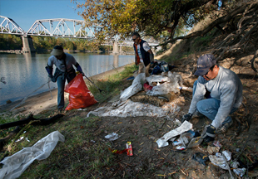
Conclusion
More images are needed to expand the TACO dataset and generalize trash detections, but this will enable:
Car and drone mounted cameras can be used to measure trash in the environment
Apps that use a picture to chose which trash bin an item belongs in
Trash monitoring to enforce zero waste standards

Slide 22
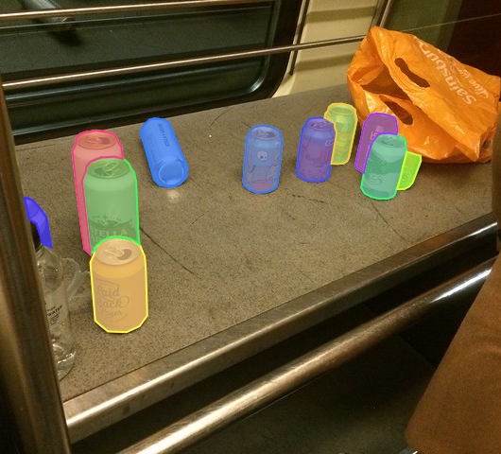
Questions?
References available by email julianofhernandez@csus.edu

